Slide 1

Forecasting the COVID-19 trend based on the combination of network information
Author:Hanyu Lu, Qiuyuan Xu

Slide 2

Introduction
Problems Caused by COVID-19
What role does the social media play
What role does the people’s concern and interest about COVID

Slide 3
What data we choose
Q：What role does the people’s concern and interest about COVID
A：The frequency of the times people serach related topic on google, which is google trend
Q：What role does the social media play
A：Sentiment analysis based on Twitter

Slide 4
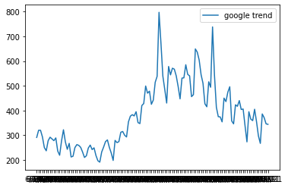
Data Description
Google trend:show people’s concern and interests by exhibiting the frequency of words that people search in Google.
Google trend about COVID19 topic

Slide 5
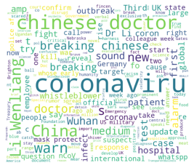
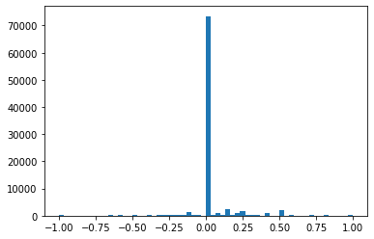
Data Description-emotion analysis
Twitter data
Wordcloud
emotion value frequency

Slide 6
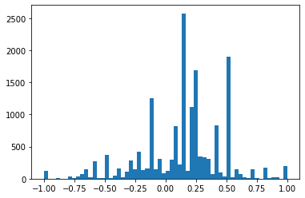
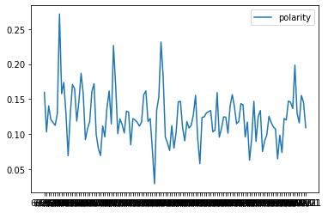
Sentiment Analysis
Twitter data
emotion score frequency without zero
2021.6-2021.10 emotion score(polarity)

Slide 7
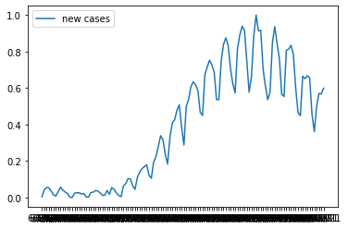
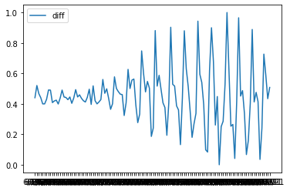
Sentiment Analysis
number of new cases
difference of number of new cases
comparing with the last day

Slide 8
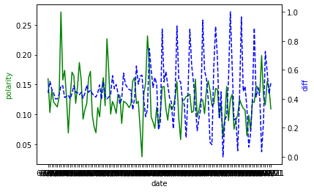
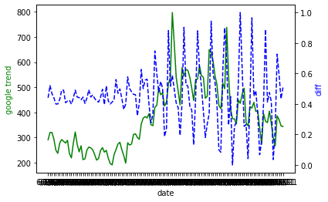
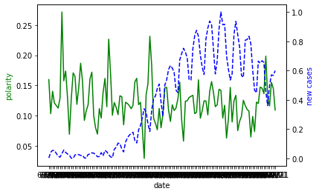
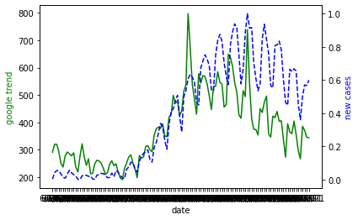
Sentiment Analysis
Polarity and difference
Google Trend and difference
polarity and nuber of new cases
Google Trend and number of new cases

Slide 9
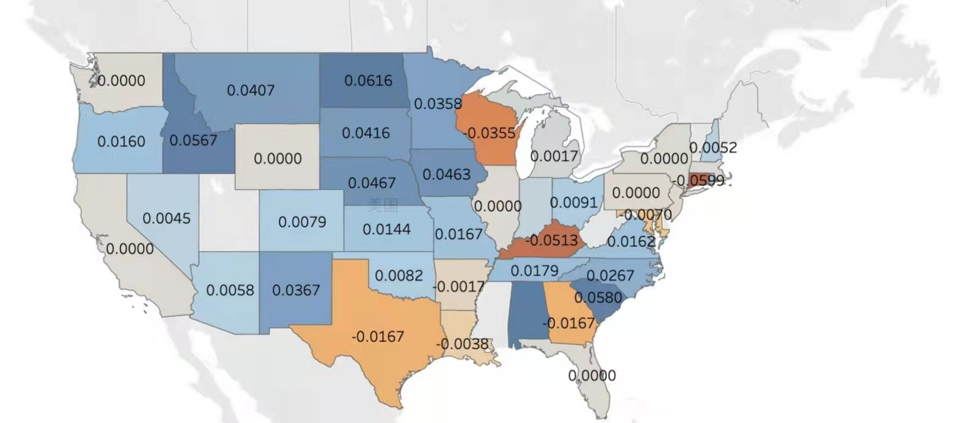
Sentiment Analysis
emotion score in America

Slide 10
Prediction-Method
Linear Regression: Combines a set of input(x)and the solution(y) which could be predicted by the input.
SVR:By using SVR, we have the flexibilityto define the acceptable range in the model and find the appropriateline to fit the data. It allows us to choose acceptable error margin()and acceptable error rate.

Slide 11
Prediction-Method
ARIMA: a class of models to forecast future values given given time seriesbased on its own past values. Any ‘non-seasonal’ time series thatexhibits patterns and is not a random white noise can be modeledwith ARIMA models.
TCN:TCN(Temporal Convolutional Network): consists of di-lated, causal 1D convolutional layers with the same input and outputlengths. It is designed based on two basic principles. Firstly, the con-volutions are causal, so there is no information leakage from futureto past. Secondly,the architecture can take a any length of sequence and map it to a output sequence whith the same length.

Slide 12
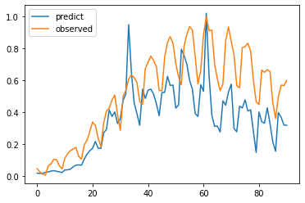
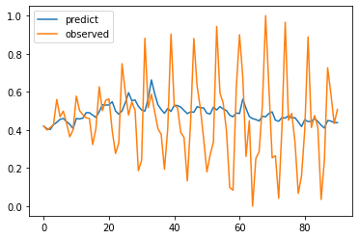
Prediction Result-Linera Regression
Prediction of new cases
Prediction of difference

Slide 13
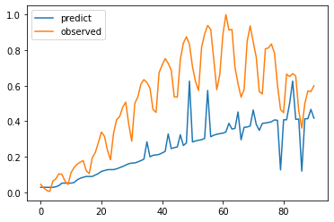
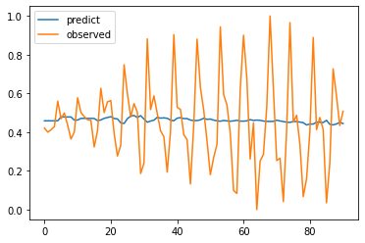
Prediction Result-SVR
Prediction of new cases
Prediction of difference

Slide 14
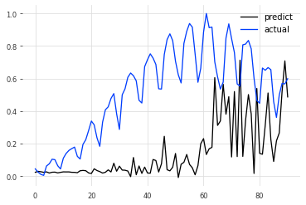
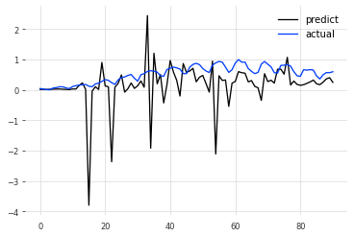
Prediction Result-TCN
Prediction of new cases
Prediction of difference

Slide 15
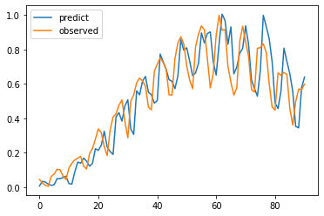
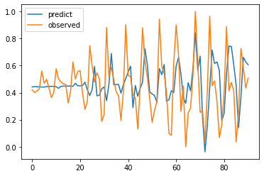
Prediction Result-ARIMA
Prediction of new cases
Prediction of difference

Slide 16
Conclusion and Discussion-models
Linear regression and svr: good at capturing the relationship between variables.
ARIMA: good at capturing the trends of the data
TCN: is good at capturing inflection points

Slide 17
Conclusion and Discussion-Data
1.people’s emotions have an impact on the predictions, but the relationship between sentiment and prediction of trend is not obvious.
2.The popularity of covid related topics have more impact on the prediction of the epidemic. google trend data show people’s concern topic.

Slide 18
Thank you so much!

